Slide 1
1 Introduction
Uses of Computer Networks
Network Hardware
Network Software
Reference Models
Example Networks
Network Standardization

Slide 2
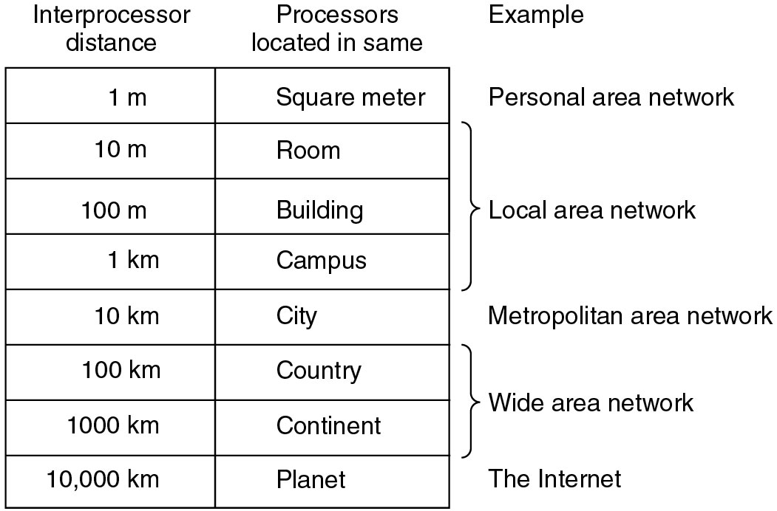
Classification by scale

Slide 3
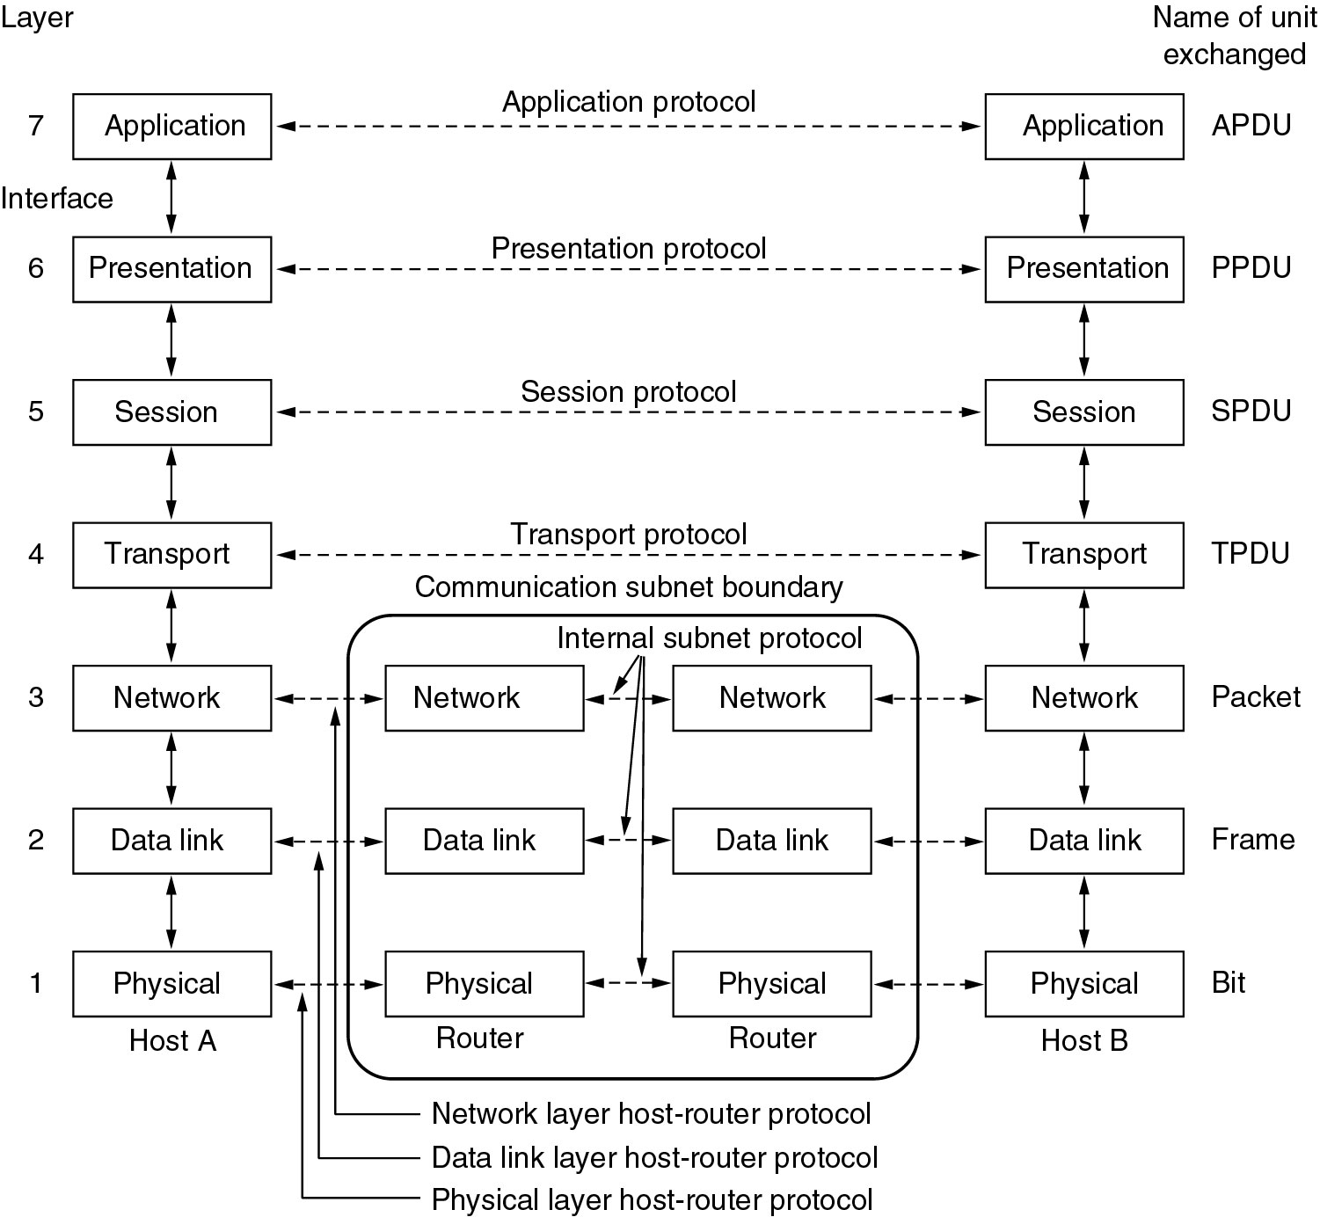
The OSI reference model

Slide 4
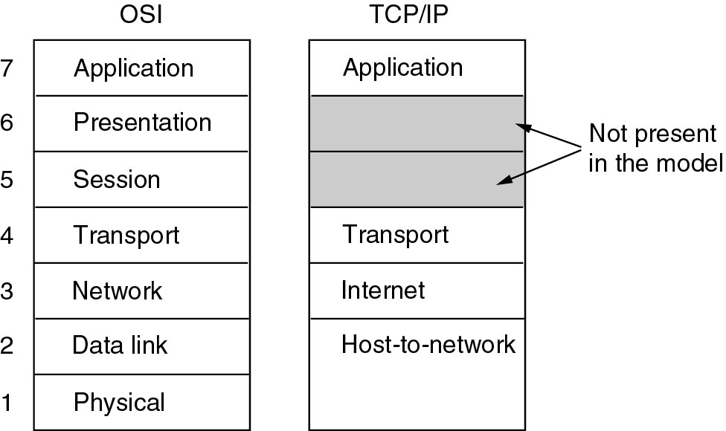
The TCP/IP Reference Model

Slide 5
Network Standardization
Telecommunications World
ITU (International Telecommunication Union)
Main sectors
Radio communications(ITU-R)
Telecommunications Standardization(ITU-T)
CCITT, Comité Consultatif International Télégraphique et Téléphonique (1956-1993)
Development(ITU-D)
International Standards World
ISO (International Standards Organization)
ANSI (American National Standards Institute)
IEEE (Institute of Electrical and Electronics Engineers)

Slide 6
2 The Physical Layer
Some concepts
Transmission medium
Wireless Transmission
Digital modulation and multiplexing
Message switch

Slide 7
Maximum Data Rate of a Channel
Nyquist's theorem (1924)
If a signal has been run through a low-pass filter of bandwidth H, the signal can be completely reconstructed by making 2H samples per second
C=2Hlog₂V
Shannon’s Theorem (1948)
Example: Voice phone line 300Hz-3300Hz, S/N dB=30dB

Slide 8
Guided Transmission Media
Magnetic Media
Twisted Pair
Coaxial Cable
Power line
Fiber Optics

Slide 9
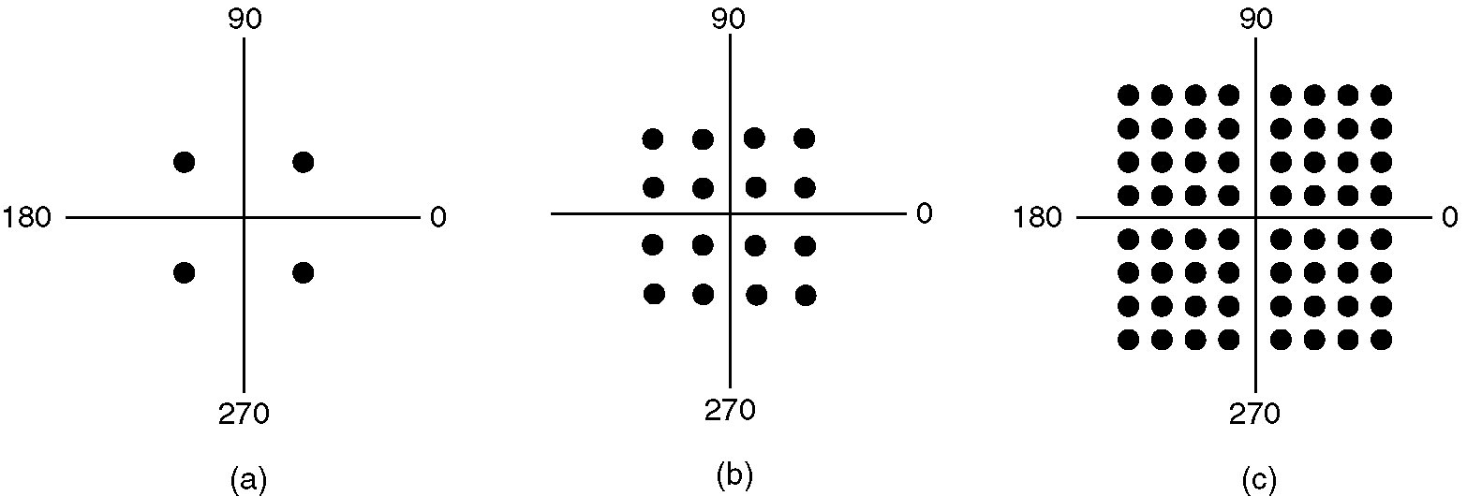
QPSK & QAM
(a) QPSK.
(b) QAM-16.
(c) QAM-64.

Slide 10
ADSL Modulation Scheme
Within each channel, a modulation scheme similar to V.34 is used
Sampling rate is 4000 baud
The line quality in each channel is monitored and data rate adjusted continuously
The actual data are sent with QAM modulation, with up to 15 bits/baud
G.dmt
8Mbps, 1Mbps
12Mbps, 1Mbps ADSL2
Standard service: 1 Mbps, 256 kbps
Improved service: 4 Mbps, 1 Mbps
Premium service: 8 Mbps, 2 Mbps

Slide 11
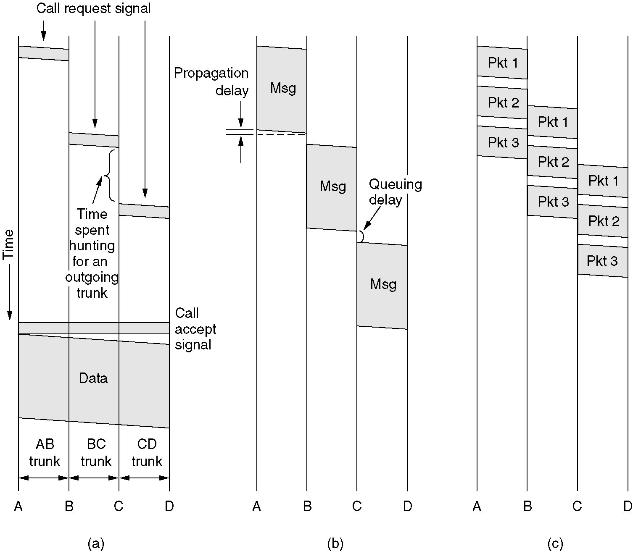
Message Switching
(a) Circuit switching (b) Message switching (c) Packet switching

Slide 12
3 Data link
Framing
Error-Control
Error-correction
Error-detection
ARQ (Automatic Repeat reQuest)
Flow control
Stop-Wait
Slide Window
Performance
ADSL、HDLC、SLIP和PPP

Slide 13
Framing
Character count(字符计数)
Flag bytes with byte stuffing (字符添充):Having each frame start and end with special bytes (IBM:BISYNC)
Bit Stuffing
Physical layer coding violations

Slide 14
比特填充
从信道上收到比特序列： 1101 0111 1110 0111 1110 1101 1011 1110 0010 1100 0101 1111 0101 1001 1111 1001，该比特序列中包含一个完整的帧，用十六进制写出该帧的内容（不包含帧的首尾标志）。
HDLC使用比特填充法成帧，帧定界符为01111110，在帧的内容中若出现连续的5个1，则立即插入1个0，应该去掉加入的0,完整的帧内容：
Notes:
1101 1011 1110 0101 1000 1011 1111 0110
D B E 5 8 B F 6

Slide 15
Hamming code
The number of check bits needed to correct single errors：
m+r+1≤ 2^{r} m: message bits, r:check bits
m message bits and r check bits, 2^{m} legal messages, n = m + r
Each legal message has n illegal codewords at a distance 1 from it
(n + 1)2^{m} ≤ 2^{n}
(m + r + 1) ≤ 2^{r}.
Example: m=7,r≥4

Slide 16
Odd & Even Parity
Coding
Each block to be sent is regarded as a matrix
A parity bit is computed separately for each column and affixed to the matrix as the last row
The matrix is then transmitted one row at a time.
Performance
Can detect a single burst of length n
A burst of length n + 1 will pass undetected if the first bit is inverted, the last bit is inverted, and all the other bits are correct
n
10010001
01010011
10100001
01010110
11001100
11101101
10001000
10011110

Slide 17
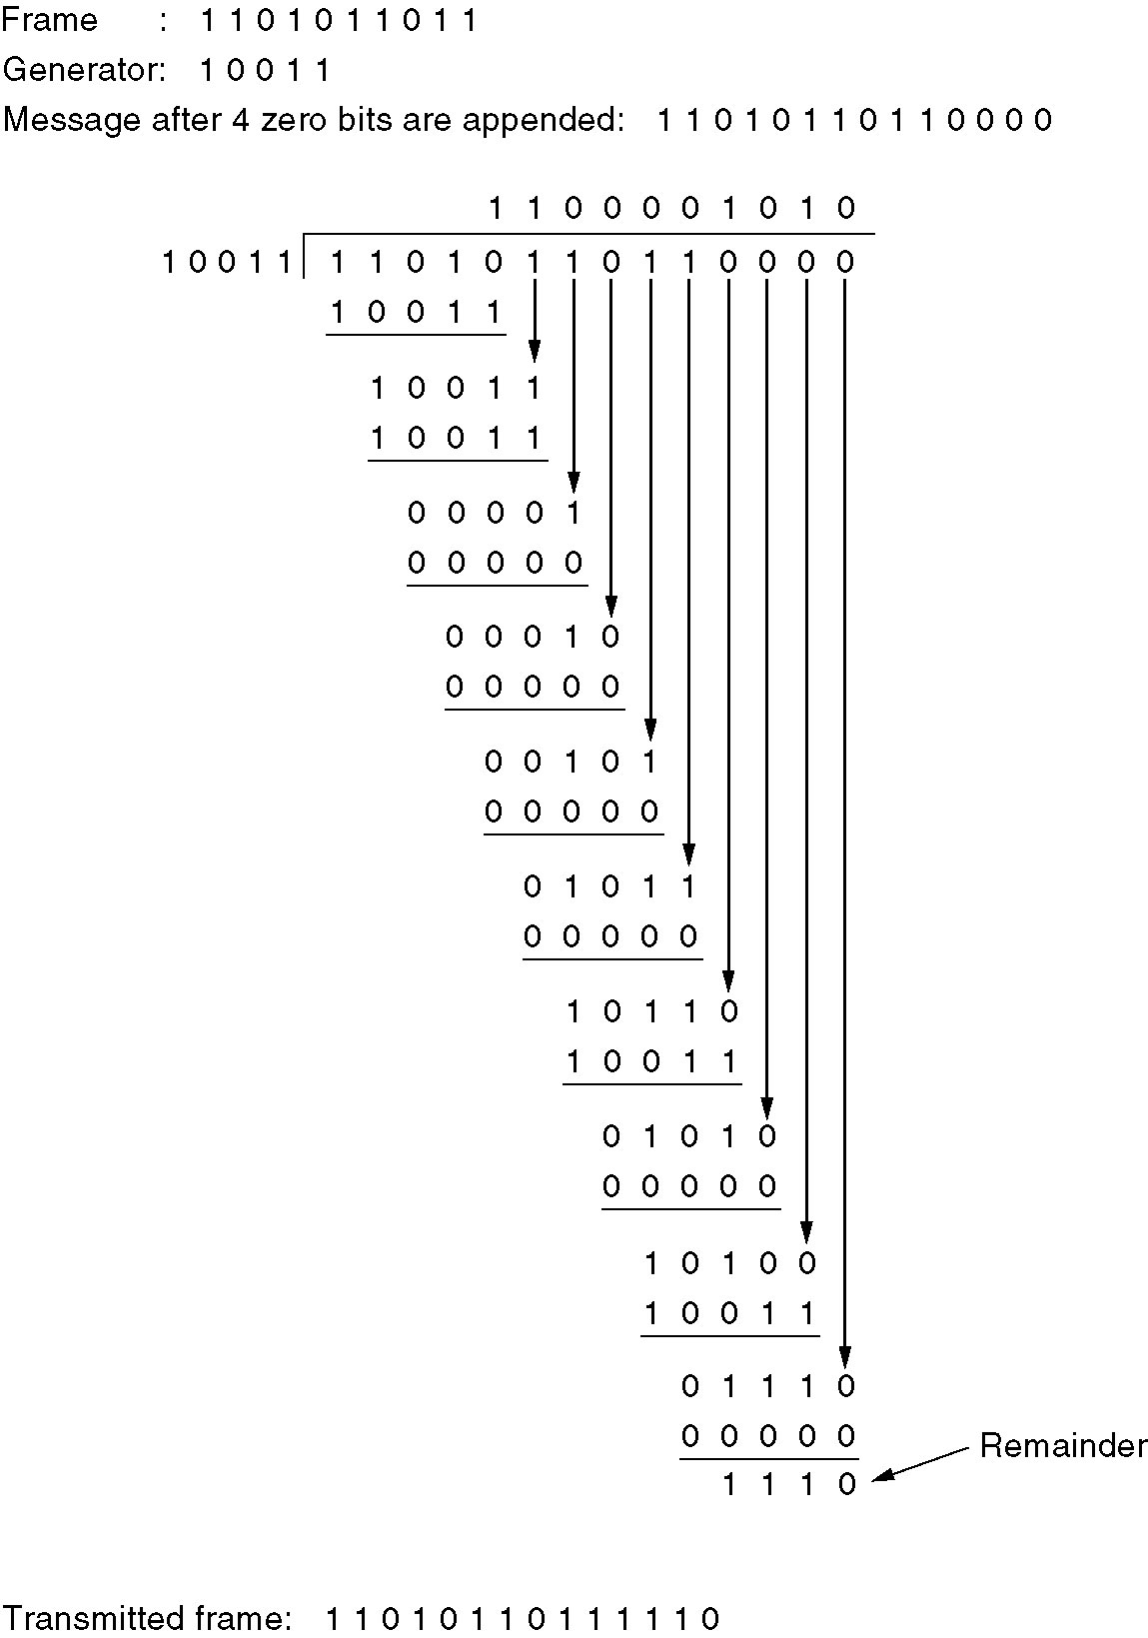
Calculation of the
polynomial code checksum.

Slide 18
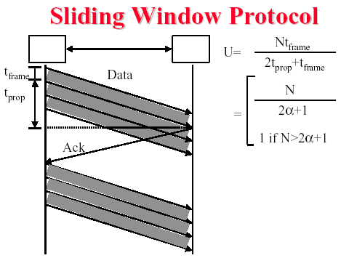
Send Window & Receive Windows
Ws+Wr <=2^{n}
Ws>=Wr
Ws,Wr<= 2^{n} ⁻¹
Piggybacking: U=N/(2+2a)

Slide 19
Example Data Link Protocols
ADSL
HDLC – High-Level Data Link Control
The Data Link Layer in the Internet
SLIP (Serial Line IP)
PPP (Point-to-Point Protocol)

Slide 20
4 MAC
Channel allocation algorithms
ALOHA,S-ALOHA,CSMA,CSMA/CD,
Collision-Free Protocols : bit-map,binary countdown,Token
Limited-Contention Protocols
LAN: IEEE802.3, HIGH-SPEED LANS (802.3u)
Gigabit Ethernet(802.3z)
IEEE802.11(WLAN) LLC(802.2)
BRIDGE: transparent bridge
REPEATER,HUB, BRIDGE,SWITCH,ROUTER
VLAN

Slide 21
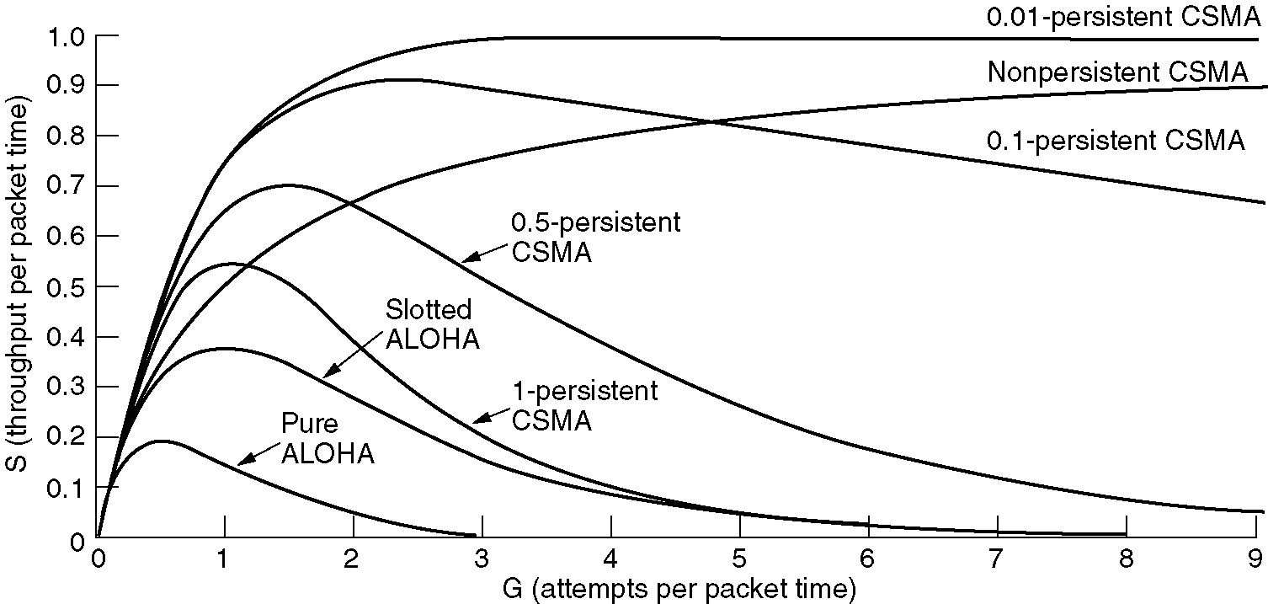
Persistent and Nonpersistent CSMA
Comparison of the channel utilization versus load for various random access protocols

Slide 22
CSMA/CD: Contention period(2)
CSMA/CD with a single channel is inherently a half-duplex system

Slide 23
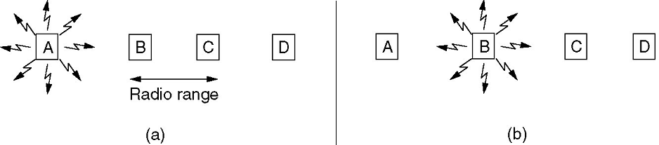
Problems
Radio transmitter & receiver
Radio transmitters have some fixed range.
In some wireless LANs, not all stations are within range of one another
Interference at the receiver, not at the sender
CSMA/CD is not appropriate
Hidden station problem
Exposed station problem
(a) A transmitting (b) B transmitting

Slide 24
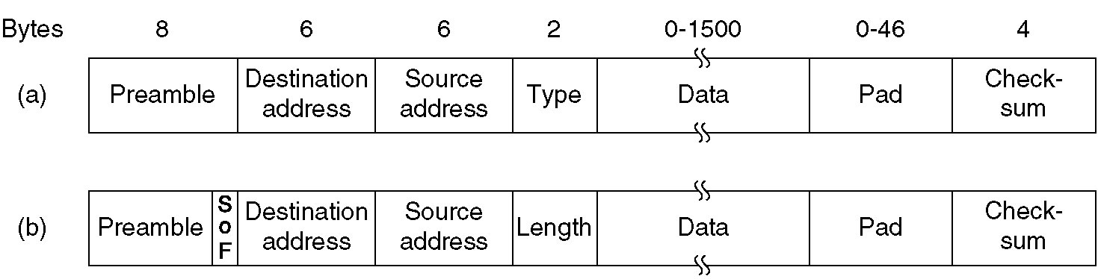
Ethernet MAC Sublayer Protocol
Type ( 0806:ARP, 0800:IP 8137:IPX)
Frame formats. (a) DIX Ethernet, (b) IEEE 802.3.

Slide 25
Frame length
Maximum frame length
1514 byes (Data length 1500 bytes)
Based on the fact that a transceiver needs enough RAM to hold an entire frame and RAM was expensive in 1978
Minimum frame length
Valid frames must be at least 64 bytes long
If data portion is less than 46 bytes, Pad field is used to fill out the frame to the minimum size
Prevent a station from completing the transmission of a short frame before the first bit has even reached the far end of the cable, where it may collide with another frame
network speed
maximum cable length

Slide 26
Hub: Half-duplex Mode
Simulating classic Ethernet
Electrically connects all the lines internally
Collisions are possible, so CSMA/CD protocol is required
Problem: A radius of 25 meters
Solutions
Carrier extension
Add padding after the normal frame to extend the frame to 512 bytes (Padding is added by the sending hardware and removed by the receiving hardware)
Frame bursting
Allows a sender to transmit a concatenated sequence of multiple frames in a single transmission
Remain the radius of the network to 200 meters

Slide 27
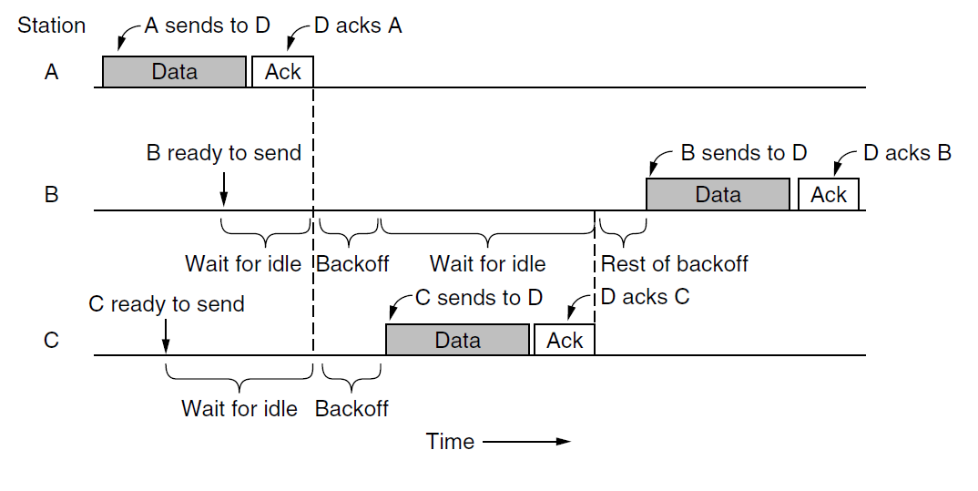
CSMA/CA

Slide 28
QOS:TXOP
Two stations: 6Mbps and 54M bps
They each get to send one frame, both get 5.4Mbps on average
Use TXOP
They get 3 Mbps and 27 Mbps, respectively

Slide 29
Learning Bridge
Operates in promiscuous mode
Accepting every frame transmitted on all the LANs to which it is attached
Station table
Lists each possible destination and tell which output line (LAN) it belongs on
Routing procedure for an incoming frame
If destination LAN and source LAN are the same, discard the frame
If destination LAN and source LAN are different, forward the frame
If destination LAN is unknown or multicast/broadcast address, use flooding algorithm
Flooding algorithm: output on all the LANs to which the bridge is connected except the one it arrived on

Slide 30
Station table: Backward Learning
Init
When the bridges are first plugged in, all the hash tables are empty
Add
Bridges operate in promiscuous mode, so they see every frame sent on any of their LANs
By looking at the source address, they can tell which machine is accessible on which LAN

Slide 31
Dynamic topologies
Problem
The topology can change as machines and bridges are powered up and down and moved around
Solution
Whenever a hash table entry is made, the arrival time of the frame is noted in the entry
Whenever a frame whose source is already in the table arrives, its entry is updated with the current time
Periodically scan the hash table and purges all entries more than a few minutes old
If a computer is unplugged from its LAN, moved around the building, and plugged in again somewhere else, within a few minutes it will be back in normal operation, without any manual intervention
This algorithm also means that if a machine is quiet for a few minutes, any traffic sent to it will have to be flooded until it next sends a frame itself

Slide 32
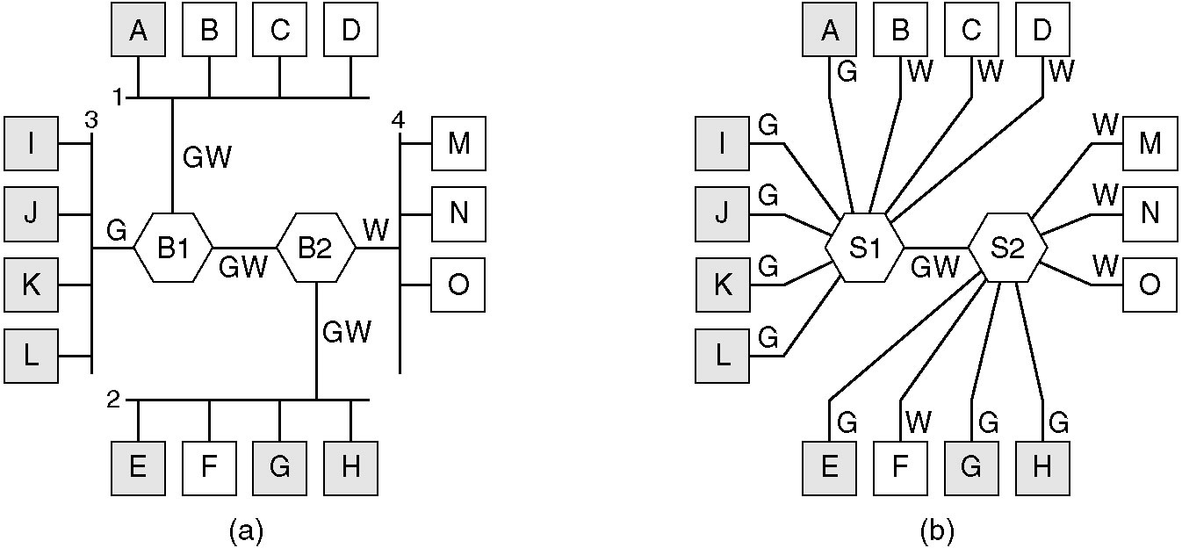
Virtual LANs
(a) Four physical LANs organized into two VLANs, gray and white, by two bridges.
(b) The same 15 machines organized into two VLANs by switches.

Slide 33
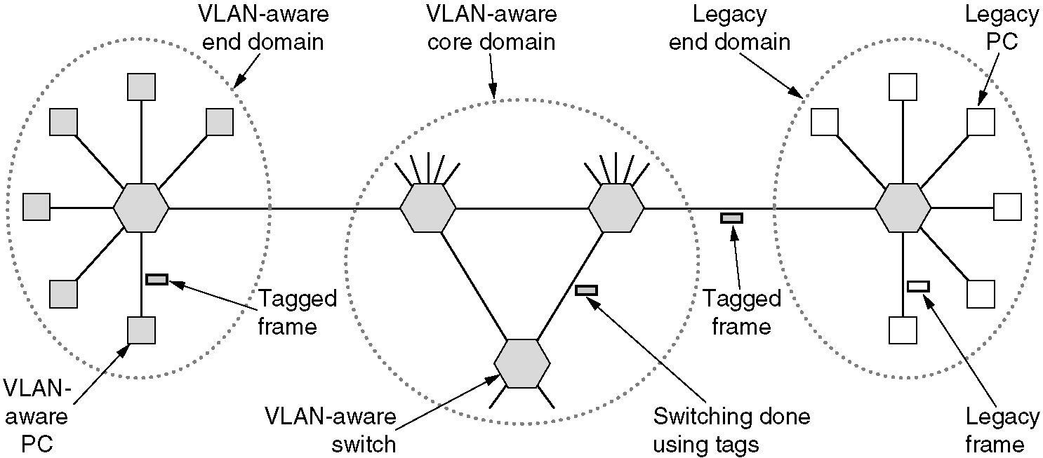
The IEEE 802.1Q Standard
Transition from legacy Ethernet to VLAN-aware Ethernet.
The shaded symbols are VLAN aware. The empty ones are not.

Slide 34
5 Network
Network Layer Design Issues
Routing Algorithms
Congestion Control Algorithms
Internetworking
IP

Slide 35
Distance Vector Routing
Routed by rumor
Each router maintains a table
The best known distance to each destination
The distance might be number of hops, time delay in milliseconds, …
Which line to use
The table is updated by exchanging information with neighbors
Send Routing information (Destination, Distance)
Periodically (RIP Routing Information Protocol:30 seconds)
Whenever table changes (triggered update)
Receive Routing information
Update local table if receive a better route
Refresh existing routes
Delete routing table items if they time out (RIP 180s)

Slide 36
Link State Routing
Each router must do the following
Discover its neighbors, learn their network address
Setting Link Costs
Construct a packet (LSP: Link-state Packet) telling all it has just learned
Send LSP to all other routers (not only neighbors) reliably
Compute the shortest path to every other router

Slide 37
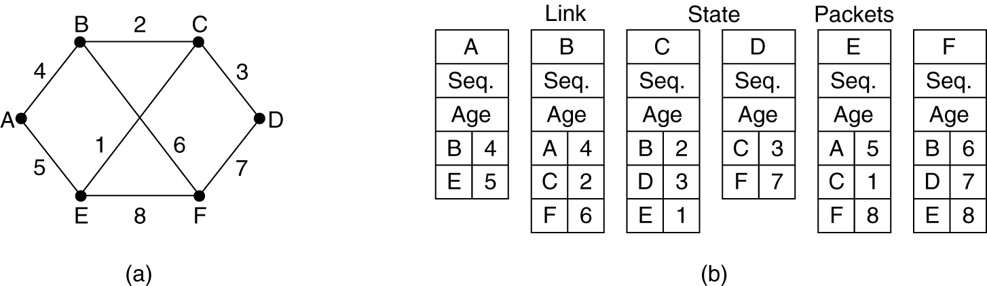
3. Building Link State Packets
(a) A subnet. (b) The link state packets for this subnet
When to build LSP
Build LSP periodically
Build LSP when some significant event occurs
such as a line or neighbor going down or coming back up again or changing its properties appreciably

Slide 38
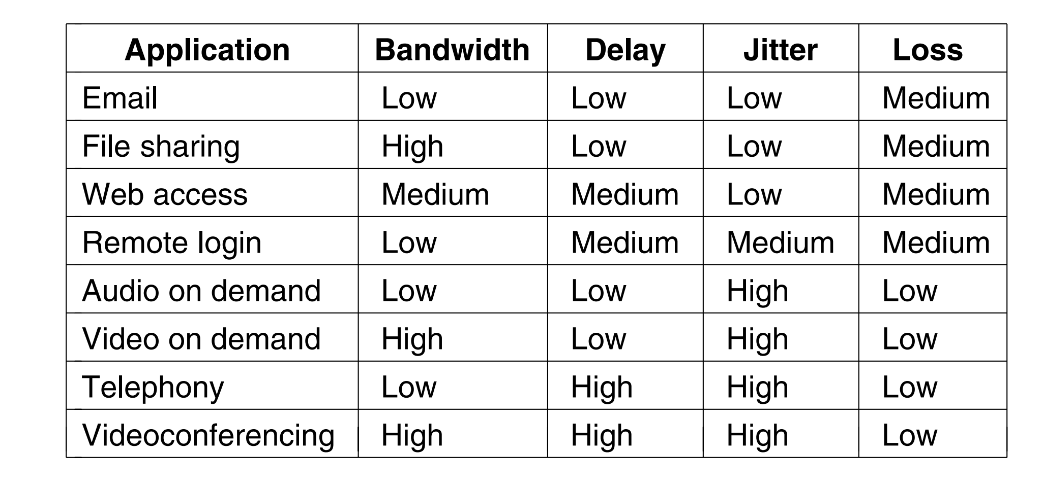
QOS

Slide 39
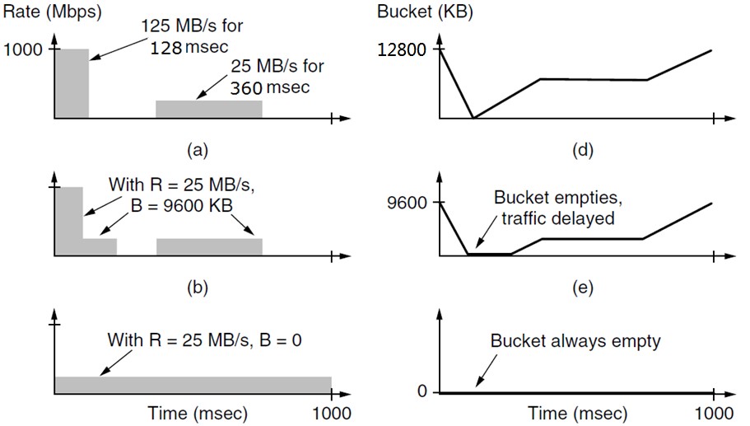
The Token Bucket Algorithm
Notes:
125*128/1000=16M 25*960/1000=9M
125*96/1000=12M,25*160=4M
25*1000/1000=25M

Slide 40
Length of Maximum Rate Burst
burst length S sec
token bucket capacity B bytes
token arrival rate R bytes/sec
maximum output rate M bytes/sec
B + RS = MS
S = B/(M - R )
B=9600KB, M = 125 MB/s, R=25 MB/s
S=9600/(125 – 25)=96 ms

Slide 41
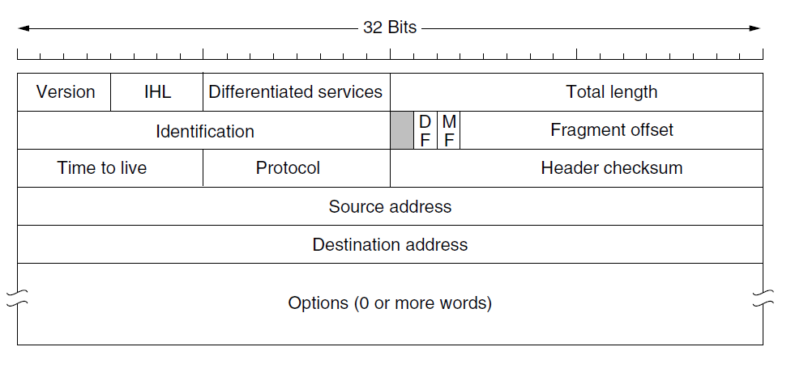
The IPv4 Header

Slide 42
Example
45 00 00 30
82 fc 40 00
80 06 f5 a5
c0 a8 01 01
c0 a8 01 65
06 64 31 ba 22 68 b9 90 00 00 00 00 70 02 ff ff ec e2 00 00
Notes:
128.168.177.153________59.64.110.213________

Slide 43
Subnet
将IP地址空间192.168.1.0/24按网络号递增顺序分配给3个局域网LAN1～LAN3
子网 | 分配地址数 | 网络地址 | 子网掩码
LAN1 | 95
LAN2 | 36
LAN3 | 46

Slide 44
Routing
地址/掩码 | 下一跳
135.46.56.0/22 | 接口0
135.46.60.0/22 | 接口1
192.53.40.0/23 | 路由器1
默认(0.0.0.0/0) | 路由器2
(a) 135.46.63.10
(b) 135.46.57.14
(c) 135.46.52.2
(d) 192.53.40.7
(e) 192.53.56.7

Slide 45
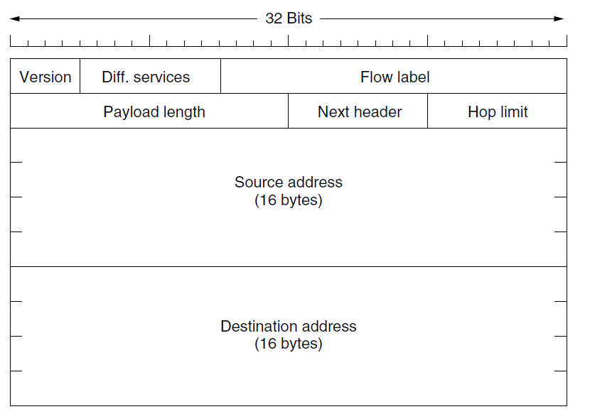
The Main IPv6 Header

Slide 46
ICMP (Internet Control Message Protocol)
ICMP message is encapsulated in an IP packet
DESTINATION UNREACHABLE
a router cannot locate the destination
a packet with the DF bit cannot be delivered because a ''small-packet'' network stands in the way
TIME EXCEEDED
a packet is dropped because its TTL counter has reached zero
SOURCE QUENCH
Choke packet：When a host received this message, it was expected to slow down
REDIRECT
a router notices that a packet seems to be routed wrong
It is used by the router to tell the sending host about the probable error
ECHO and ECHO REPLY
TIMESTAMP REQUEST and TIMESTAMP REPLY
The ROUTER ADVERTISEMENT and ROUTER SOLICITATION
used to let hosts find nearby routers

Slide 47
ICMP的几种应用
traceroute
利用TTL=0回送ICMP报文测路径，发TTL=1, =2, =3, ..., 的报文,回送ICMP报文的节点地址就是路径地址
主机分片
以太网上主机TCP发送DF=1的1500字节IP报文经ADSL路由器MTU=1492,回ICMP报文报告MTU=1492,TCP重传并且后续发送报片长度均为1492
目的不可达
主机TCP建连接，向远端网络未开机计算机发送IP报文，远端网络的路由器回ICMP报文报告主机不可达
路由重定向
路由器收到IP报，转发，并用ICMP通告更好的转发路由器地址

Slide 48
ARP,DHCP
OSPF,RIP,BGP,ISIS

Slide 49
6 Transport
Transport service
Elements of transport protocols:
Addressing
Connection
Flow Control
Congestion control
The Transport Layer in Internet
UDP/TCP
connection management
window management
congestion management

Slide 50
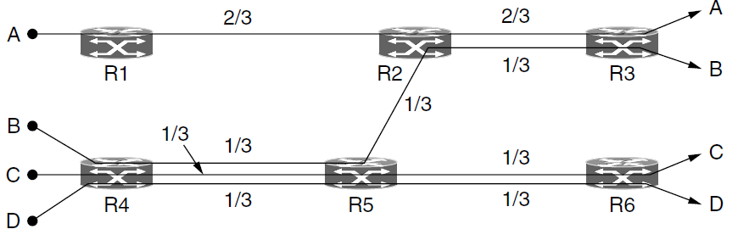
Max-Min Fairness
How to divide bandwidth between transport senders
Networks do not have a strict bandwidth reservation for each flow or connection
IP routers often have all connections competing for the same bandwidth
Max-min fairness
If the bandwidth given to one flow cannot be increased without decreasing the bandwidth given to another flow with an allocation that is no larger

Slide 51
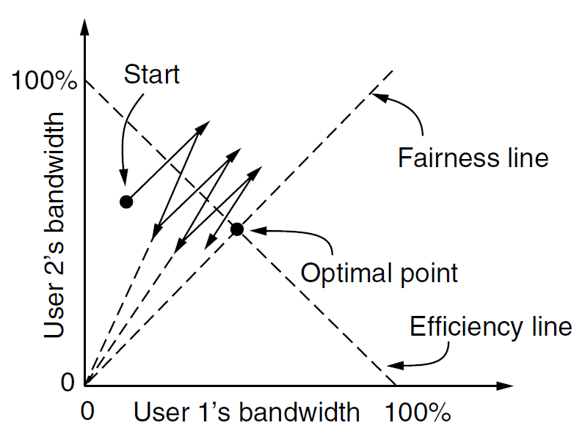
AIMD Control Law
AIMD(Additive Increase Multiplicative Decrease) does converge to optimal point both fair and efficient

Slide 52
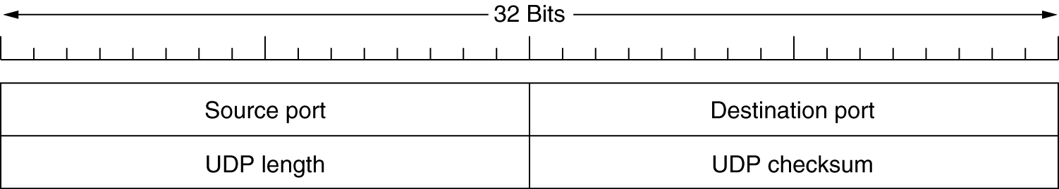
UDP Header
Checksum
Optional: Stored as 0 if not computed (a true computed 0 is stored as all 1s)
The checksum algorithm is simply to add up all the 16-bit words in one’s complement and to take the one’s complement of the sum
Including header、data and the pseudoheader in the UDP checksum computation helps detect misdelivered packets

Slide 53
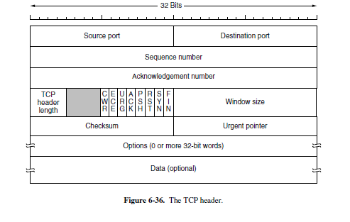
TCP Segment Header

Slide 54
TCP Connection Establishment (1)

Slide 55
TCP Connection Release(2)

Slide 56
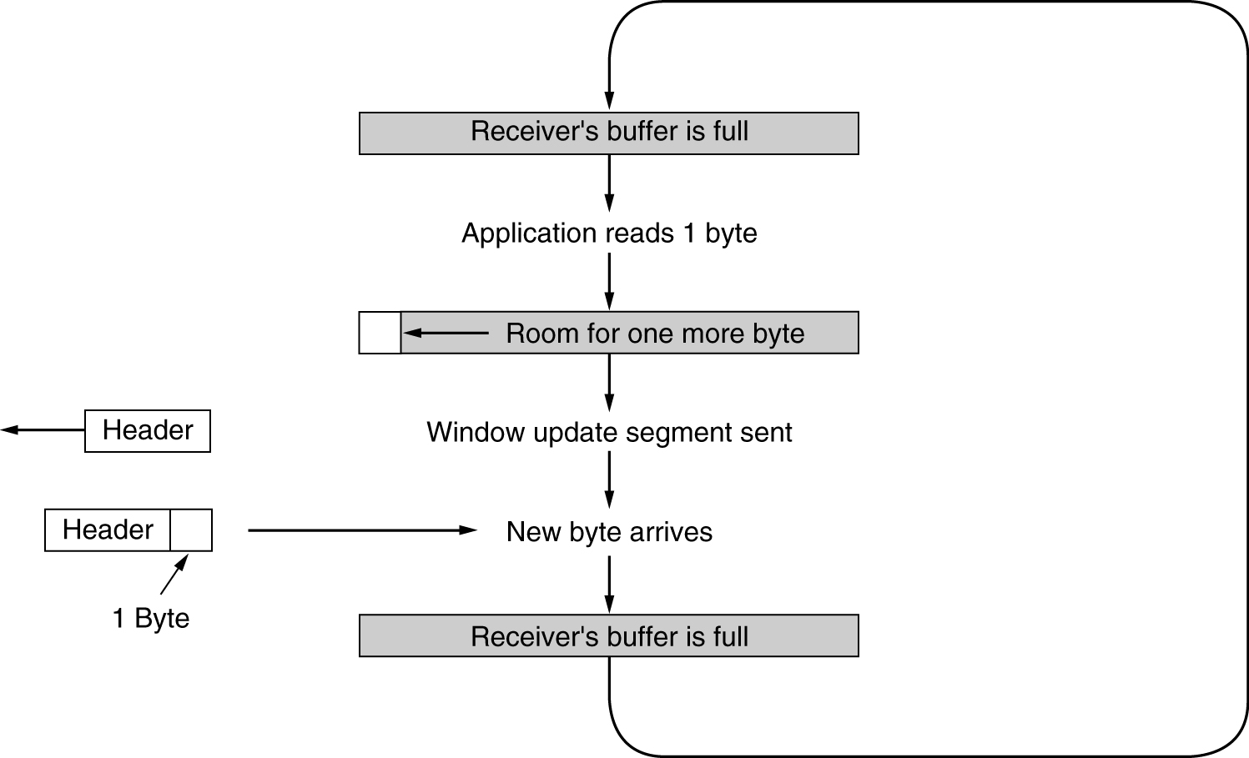
Silly Window Syndrome
Clark’s solution
Receiver should not send a window update until it can handle the MSS or its buffer is half empty, whichever is smaller

Slide 57
Retransmission Timer: Jacobson Algorithm
Solution
Use a dynamic algorithm that adjusts the timeout interval, based on continuous measurements of network performance
Jacobson’s Algorithm
R: How long the successful acknowledgement took
α: A smoothing factor, typically α = 7/8.
RTT: Estimate of the round-trip time
RTT= αRTT+(1-α)R
Timeout interval
Timeout = β RTT , Typically β=2
Enhanced Algorithm
Problem: a constant value was inflexible because it failed to respond when the variance went up
Mean deviation (a cheap estimator of the standard deviation)
RTTVAR= β RTTVAR +(1- β)|RTT-R|, Typically β =3/4
Timeout interval
Timeout = RTT+4 RTTVAR
less than 1% packets come in more than four standard deviations late

Slide 58
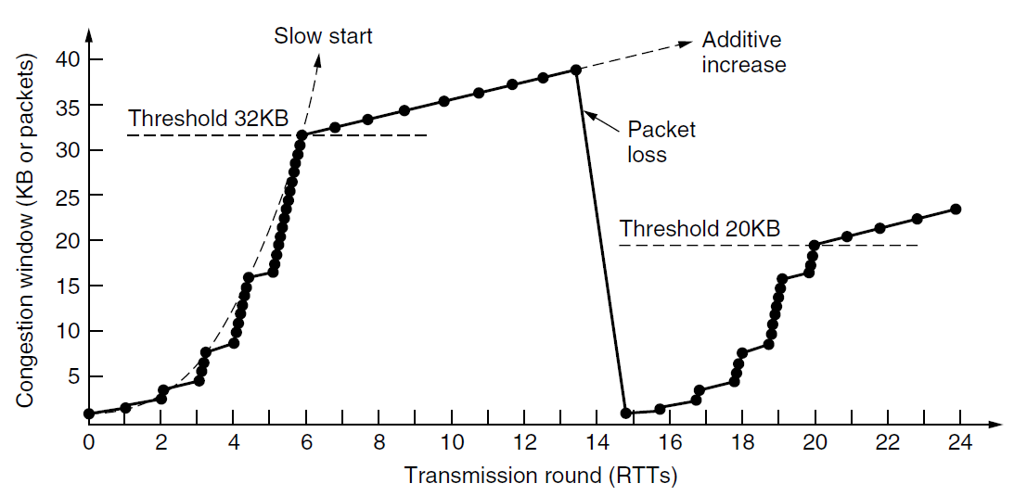
TCP Tahoe
Slow start followed by additive increase in TCP Tahoe

Slide 59
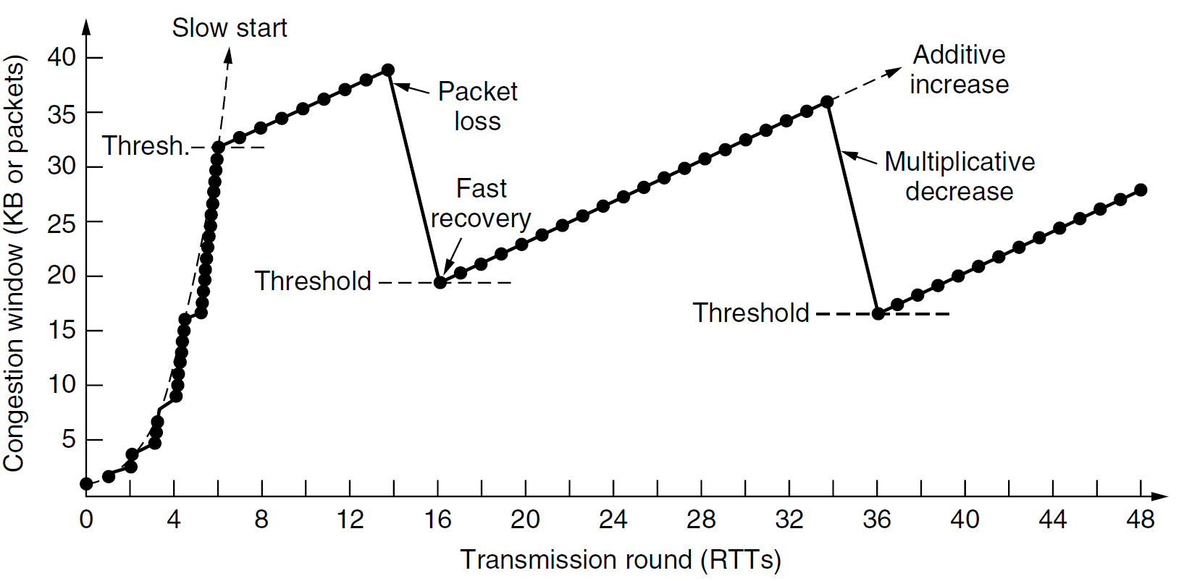
TCP Reno
Fast recovery and the sawtooth pattern of TCP Reno

Slide 60
7Application
DNS
Email
WWW

Slide 61
协议分析
编号 | IP包的全部内容
1 | 45 00 00 34 69 40 40 00 40 06 fe 87 c0 a8 00 76 72 f6 9e e7 89 36 00 16 a7 5f fa 2a 00 00 00 00 80 02 40 00 31 45 00 00
2 | 45 00 00 34 d4 c1 40 00 71 06 62 06 72 f6 9e e7 c0 a8 00 76 00 16 89 36 5d 8c 82 b7 a7 5f fa 2b 80 12 40 00 51 02 00 00
3 | 45 00 00 28 69 41 40 00 40 06 fe 92 c0 a8 00 76 72 f6 9e e7 89 36 00 16 a7 5f fa 2b 5d 8c 82 b8 50 10 43 80 8e 3b 00 00
4 | 45 00 00 57 69 42 40 00 40 06 fe 62 c0 a8 00 76 72 f6 9e e7 89 36 00 16 a7 5f fa 2b 5d 8c 82 b8 50 18 43 80 e4 63 00 00
 | （省略了TCP通信过程中的多个IP数据报）
5 | 45 00 00 28 69 ae 40 00 40 06 fe 25 c0 a8 00 76 72 f6 9e e7 89 36 00 16 a7 60 02 16 5d 8c 91 7c 50 11 41 e8 79 23 00 00
6 | 45 00 00 28 d6 0c 40 00 71 06 60 c7 72 f6 9e e7 c0 a8 00 76 00 16 89 36 5d 8c 91 7c a7 60 02 17 50 10 40 40 7a cb 00 00
7 | 45 00 00 28 d6 0d 40 00 71 06 60 c6 72 f6 9e e7 c0 a8 00 76 00 16 89 36 5d 8c 91 7c a7 60 02 17 50 11 40 40 7a ca 00 00
8 | 45 00 00 28 69 af 40 00 40 06 fe 24 c0 a8 00 76 72 f6 9e e7 89 36 00 16 a7 60 02 17 5d 8c 91 7d 50 10 41 e8 79 22 00 00

